Slide 1
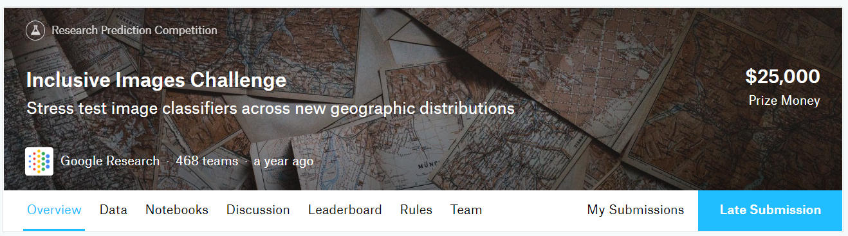
Inclusive Images Challenge
12/5/2019

Slide 2
Introduction: Inclusive images challenge
An image recognition systems that can perform well on test images drawn from different geographic distributions

Slide 3
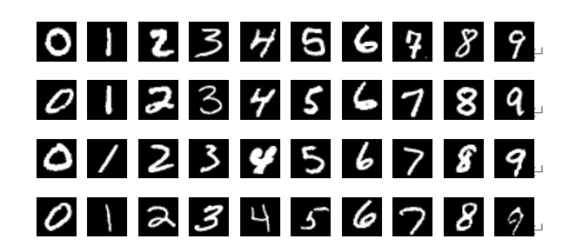
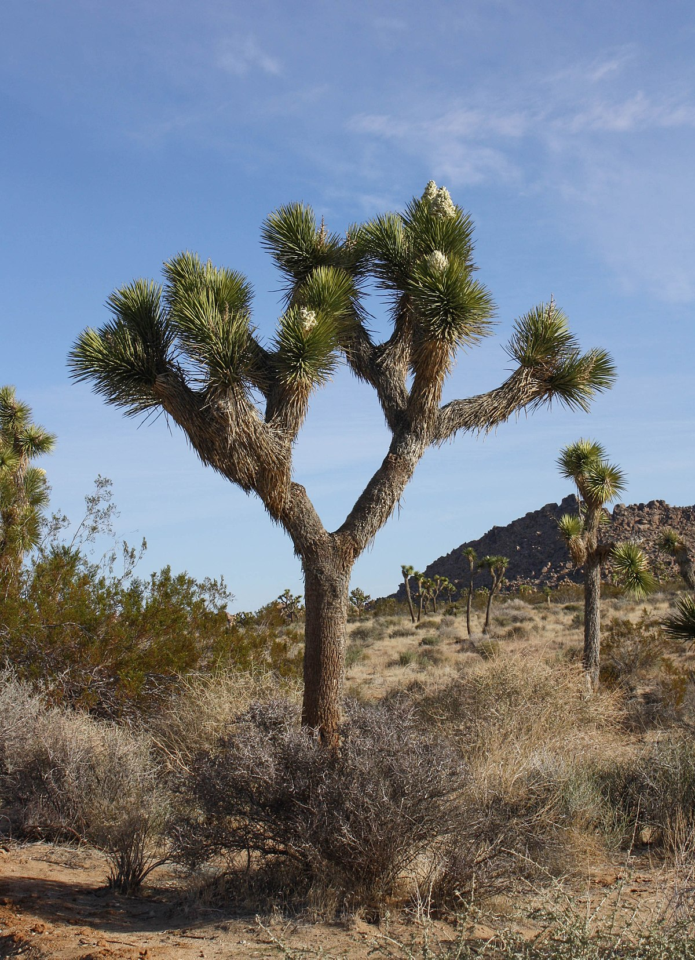
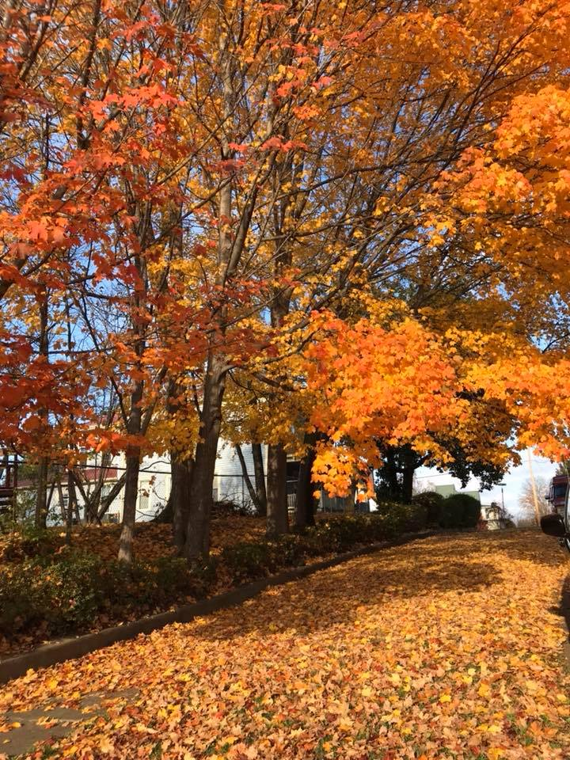
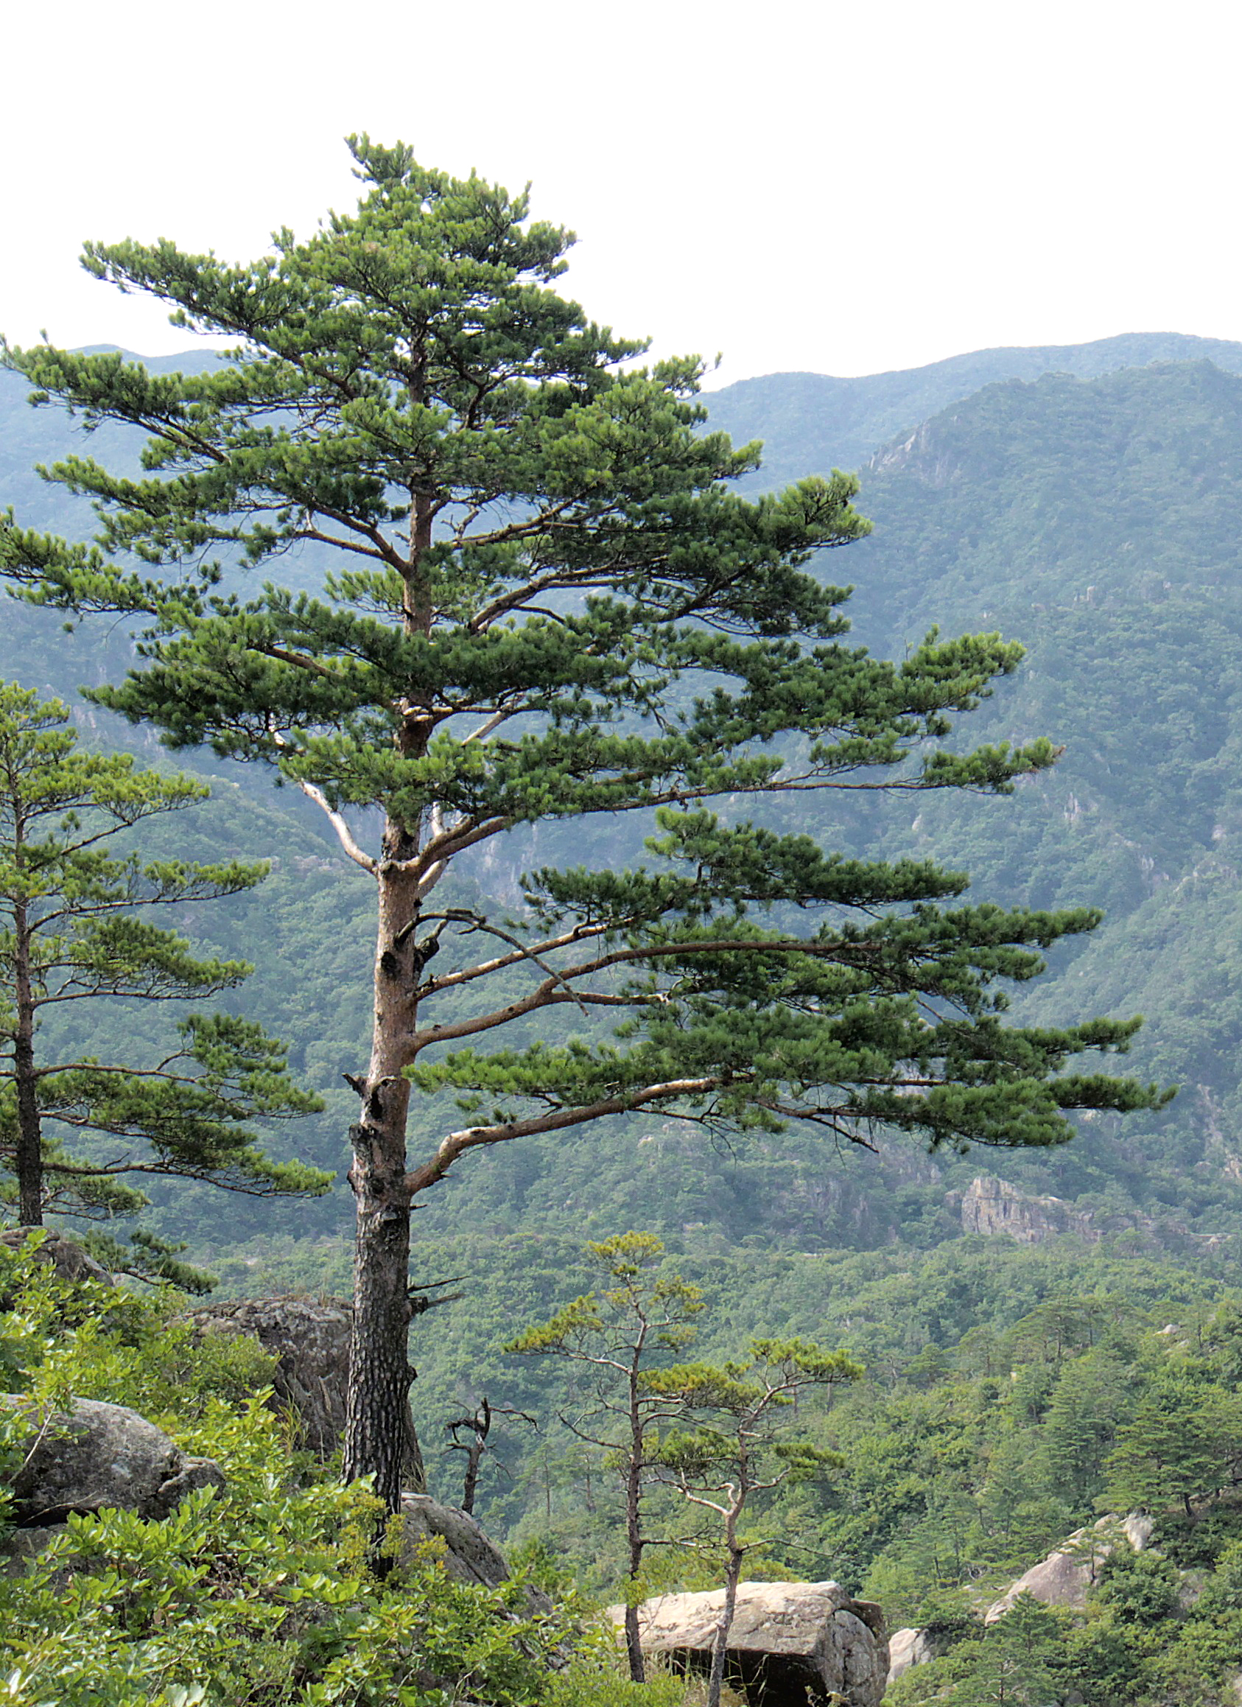
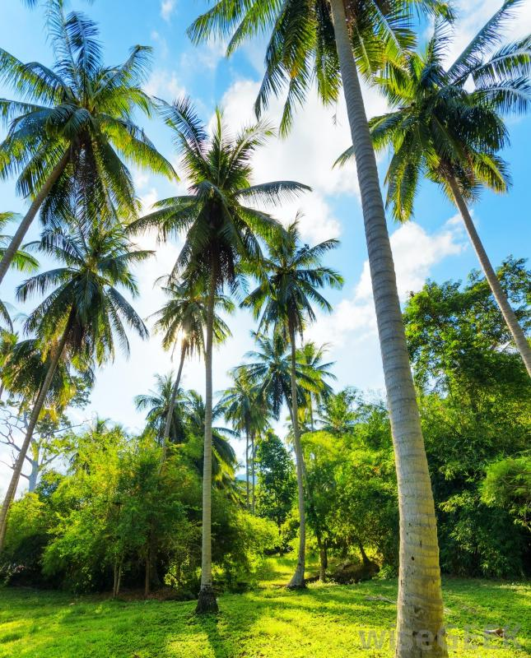
Introduction: Inclusive images challenge
General data that same classes have similar structure
Hand writing digits
Inclusive images
Geographiclly
Notes:
The real question is if how do we train a model with training data that are different test data.

Slide 4
Motivation
It is a general issue for CNN models.
The solution can be applied in other area.
Having a better understanding of deep learning algorithms

Slide 5
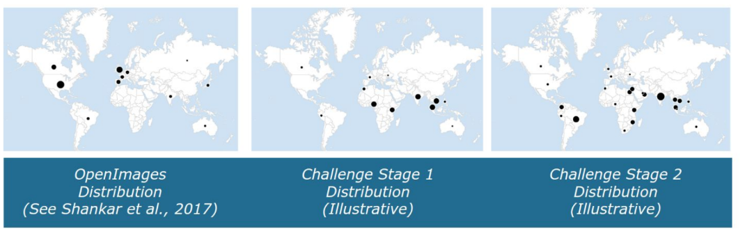
Problem statement
Given a large set of images from one geographic region train a model
generalized on another regions.
Evaluation metric: F2 score (like F1, but recall is more important than
precision).

Slide 6
Problem statement: Restrictions
Pretrained models are not allowed.
No other data allowed.
Prediction should be based on image input only(not metadata).

Slide 7
Related Work: The Winner Pavel Ostyakov
Model architectures
● PNASNet-5-Large
● NASNet-A-Large
● SENet154
● ResNet152
● ResNet101
● Densenet121
● Use cross-validation while tuning the last layer;
● Use dropout and strong augmentation while tuning the last layer;
● Choose correct weights in ensemble to perform well both on validation and public leaderboard;
● Best single model PNASNet-5-Large gives 4th place;
● The final solution contains ~300 models;

Slide 8
Related Work: the 4th place Azat Davletshin
Single Model: SE-ResNet-101
Fine- tuning
new loss function MultiLabelSoftmaxWithCrossEntropyLoss, which is easier to optimize than the classic SigmoidWithCrossEntropyLoss.
random crops and horizontal flips for training data augmentation
used all 18k labels instead of 7k labels listed in the classes_trainable.csv

Slide 9
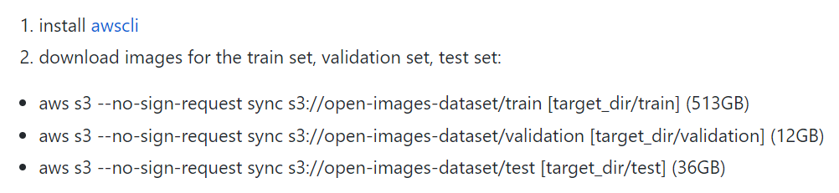
Dataset: Original
Train
● 1.7 millions images
● More than 18000 classes
Test (stage1)
● 32 thousand images
● Ground truth labels for 1 thousand images for tuning models locally

Slide 10
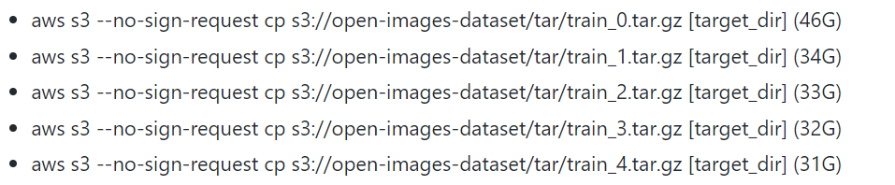
Dataset: proportional shrinked
Train
● 10 thousand image from training data
● more than 1000 classes, sorted by frequency.
Test (stage1)
● 1 thousand images from stage 1 test images.
● 100 tuning images from tune-labels.

Slide 11
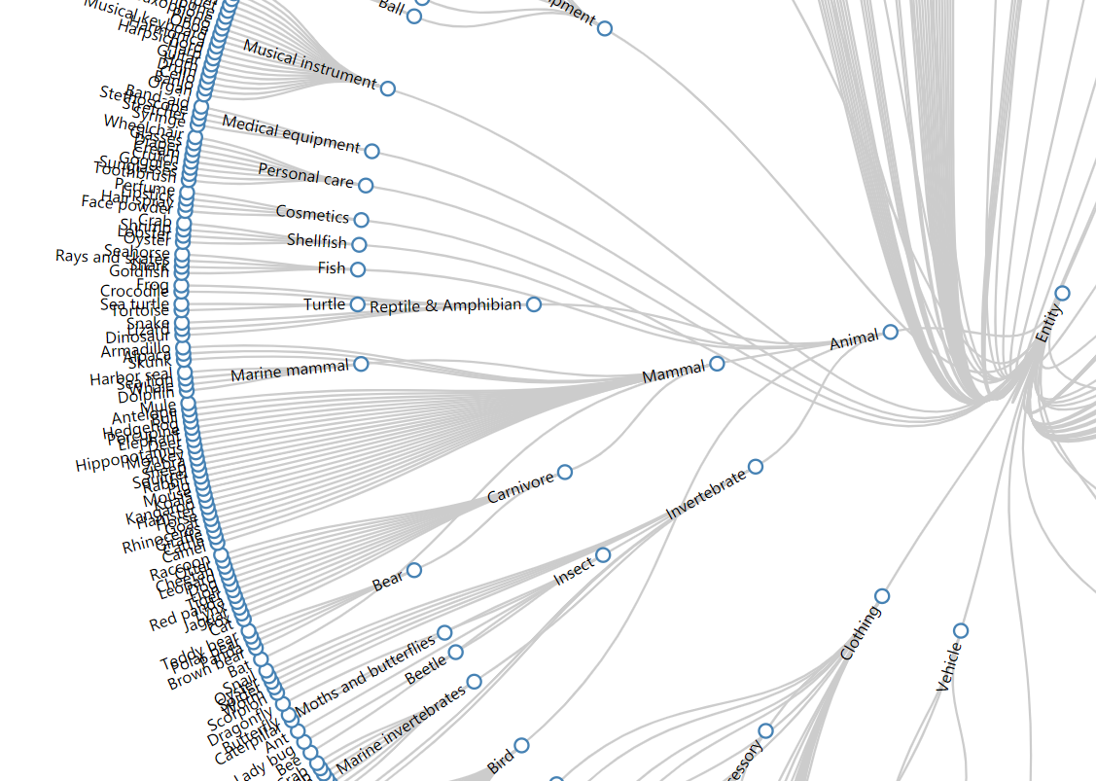
Dataset: Classes
Hierarchical structure
Higher level classes are less
Inclusive
Higher level classes are lower
Layers of CNN.

Slide 12
Data Preprocessing
● Match images with labels by imageID.
● Input images are scaled into 224*224
● Input classes were multi-hot encoded by the training classes.
● 10% training data as Validation to avoid overfitting

Slide 13

Approach: convolutional neural network
● Input: 2D array images and labels
● Layers: have multiple channels
Convolution: kernel
Pooling: averaging /max
Relu: max(0,x)
● Fully connected
● Out put: 1D array of probabilities of all classes

Slide 14
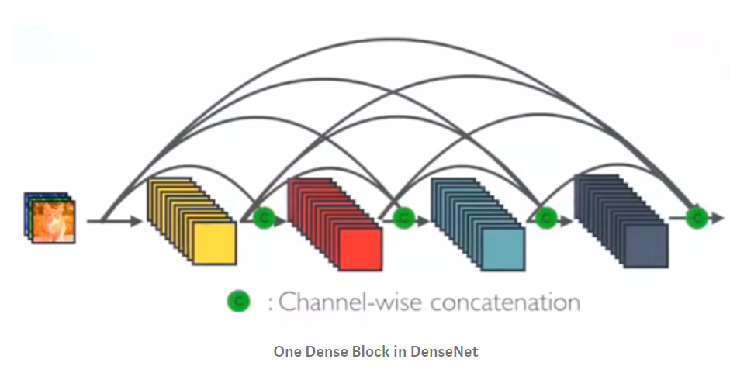
Architecture: dense net
The dense block at each layer received feature maps from all previous layers
It makes the network denser and more efficient

Slide 15
Approach: Fine tuning
Retrain the trained model with tuned labels
Frozen all layers except last one
The CNN models automatically identify the hierarchical structure, so the more diverse labels are in the end of the layers.

Slide 16
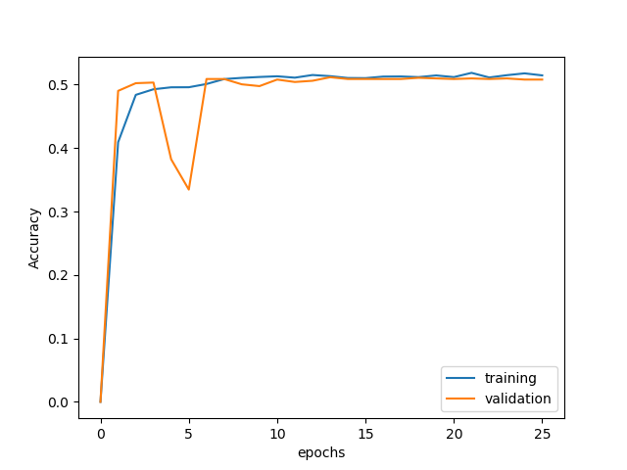
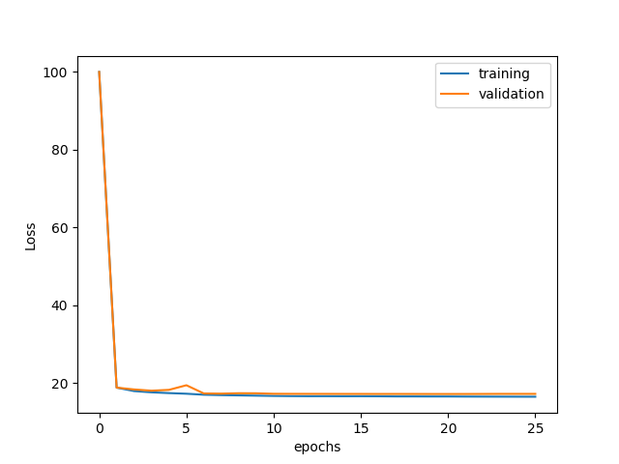
Experiments

Slide 17
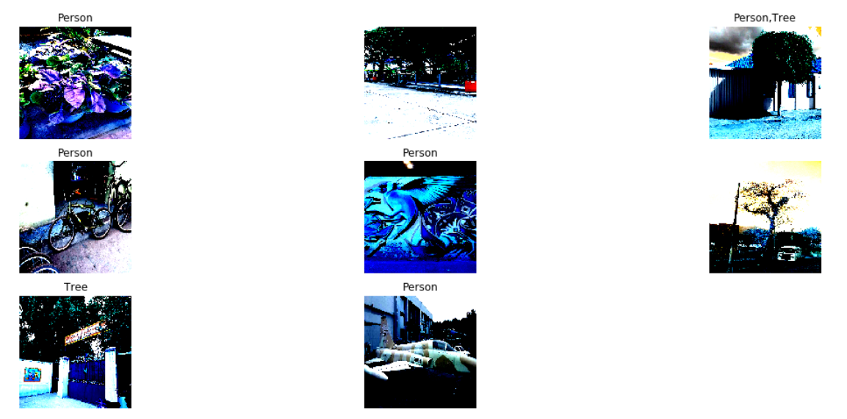
Results
F2 score=0.255

Slide 18
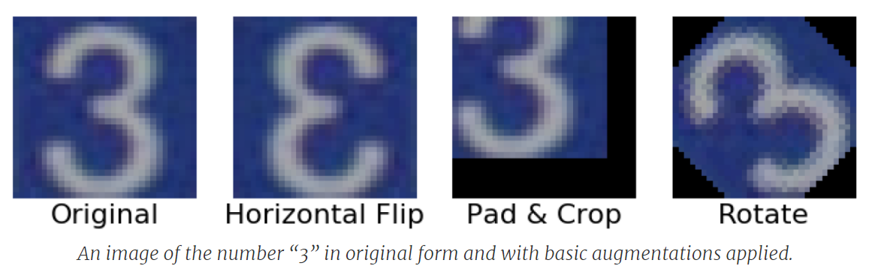
Discussion: Improvement
Weight samples and labels for ubalanced distribution
Data augmentation: random crops + random horizontal
Combing multiple models to have a better performance.

Slide 19
Conclusion: More work need to be done
The accuracy is constrained by training size.
Many variations in the data augmentation that can be tried.
Combing multiple models to have a better performance.

